Slide 1

Faculty of Computing and Engineering Sciences, SZABIST Karachi
MQTT PUBLISH/SUBSCRIBE SYSTEM WITH ESP32 & DHT22 SENSOR INTEGRATION
Ammad Khan (2212105) | Instructor: Madam Kiran Fatima | 13th May 2026

Slide 2

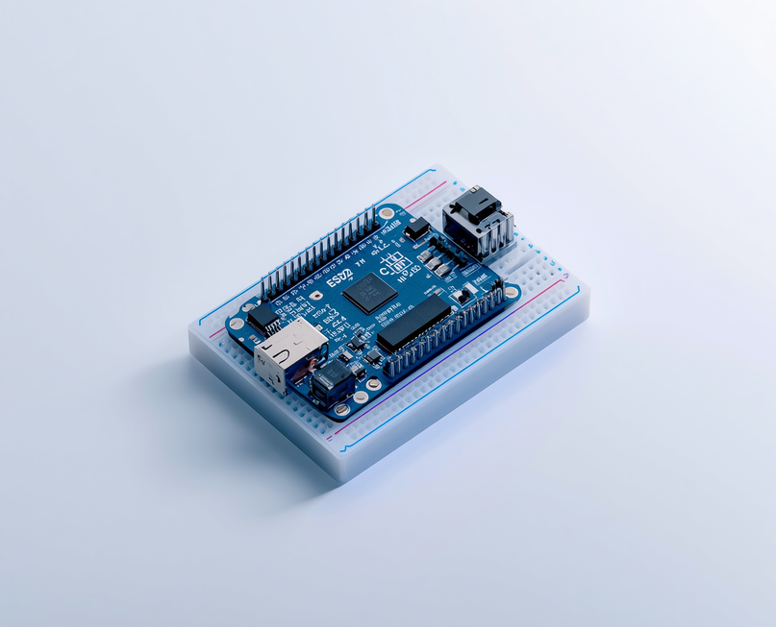
Project Overview
This project implements an MQTT Publish/Subscribe system using ESP32 microcontroller and DHT22 sensor for real-time environmental monitoring.
• Real-time temperature and humidity data transmission via Wi-Fi and MQTT broker
• Integration with Arduino Cloud for dashboard visualization
Key Objectives:
• Develop a functional MQTT Pub/Sub system
• Enable real-time data transmission with CLI interaction
• Demonstrate distributed systems concepts in IoT security context

Slide 3

Literature Review
AI-Enhanced SIEM for IoT Environments: Research demonstrates that AI-enhanced Security Information and Event Management systems reduce false positives by 37%. Unsupervised clustering algorithms detect previously unknown anomalies with 82% accuracy.
Methodology & Relevance: Study utilized IBM QRadar and Splunk logs with Random Forest and SVM classifiers. Key insight: Monitoring MQTT broker logs is critical for detecting unauthorized subscriptions and potential security attacks in IoT systems.

Slide 4


Literature Review: Machine Learning for Log Analysis in SOC Operations
Bidirectional LSTM networks achieve 94.2% detection accuracy for security threats. Federated learning approach reduces communication overhead by 60% while maintaining model performance. Hierarchical AI architecture spans edge, network, and centralized processing layers.
MQTT-specific attack detection capabilities include flooding attacks, topic enumeration attempts, and unauthorized subscription monitoring. This research directly informs security monitoring strategies for IoT broker implementations.

Slide 5

System Architecture Overview
Publisher Layer
Broker Layer
Subscriber Layer
ESP32 microcontroller with DHT22 temperature and humidity sensor. Handles Wi-Fi connectivity and data acquisition. Publishes sensor readings to MQTT broker at regular intervals for real-time environmental monitoring.
Mosquitto MQTT Broker v2.0+ running on laptop. Operates on port 1883 for message routing. Manages topic subscriptions and message distribution between publishers and subscribers in the distributed system.
Multiple subscriber endpoints: ESP32 Serial Monitor, CLI tools, and Arduino Cloud Dashboard. MQTT Topics: sensors/room1/temperature, sensors/room1/humidity. Enables real-time data visualization and monitoring.

Slide 6

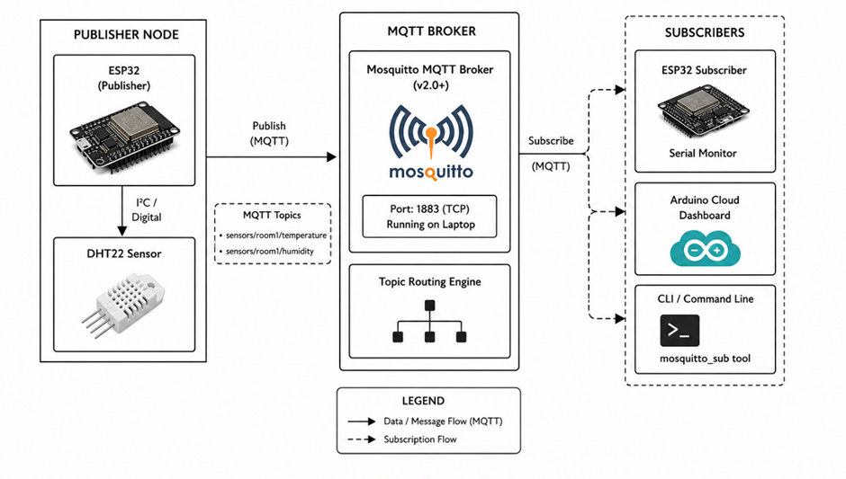
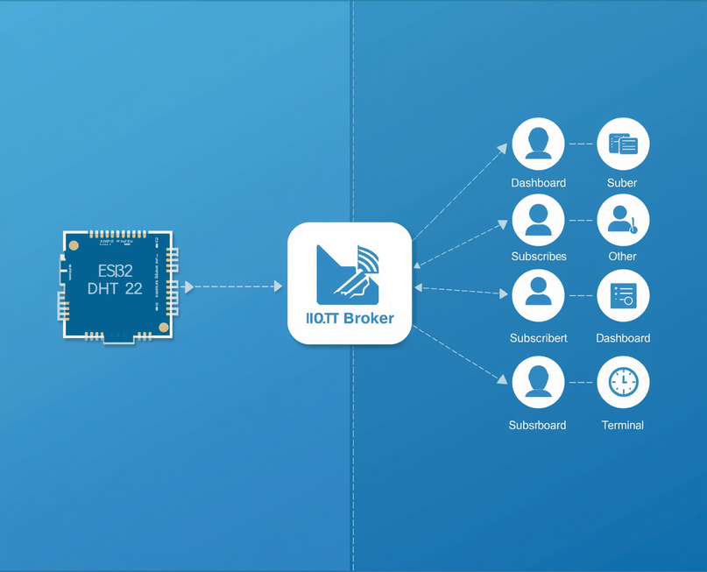
System Architecture Block Diagram
Visual representation of the three-tier distributed architecture showing data flow between components:
• Publisher Node: ESP32 + DHT22 sensor
• MQTT Broker: Mosquitto (port 1883)
• Subscribers: Serial Monitor, Arduino Cloud, CLI
• Solid arrows: Data flow
• Dashed arrows: Subscription flow

Slide 7

Hardware & Software Components
ESP32 DevKit V1
PubSubClient Library
DHT22 Sensor
USB-C Data Cable
Mosquitto Broker v2.0+
Dual-core Wi-Fi MCU
Arduino IoT Cloud
Temp & Humidity Sensing

Slide 8

Implementation Methodology - Setup and Libraries
Phase 2: Library Installations
• DHT sensor library for temperature and humidity reading
• Adafruit Unified Sensor library for standardized sensor interface
• PubSubClient library for MQTT protocol communication
• ArduinoIoTCloud library for cloud dashboard integration
• Arduino_ConnectionHandler for Wi-Fi connectivity management
Phase 1: Development Environment Setup
• Arduino IDE 2.x installation with latest stable release
• ESP32 board package configuration via Boards Manager
• USB driver installation for ESP32 DevKit V1 communication
• Workspace and project folder organization

Slide 9

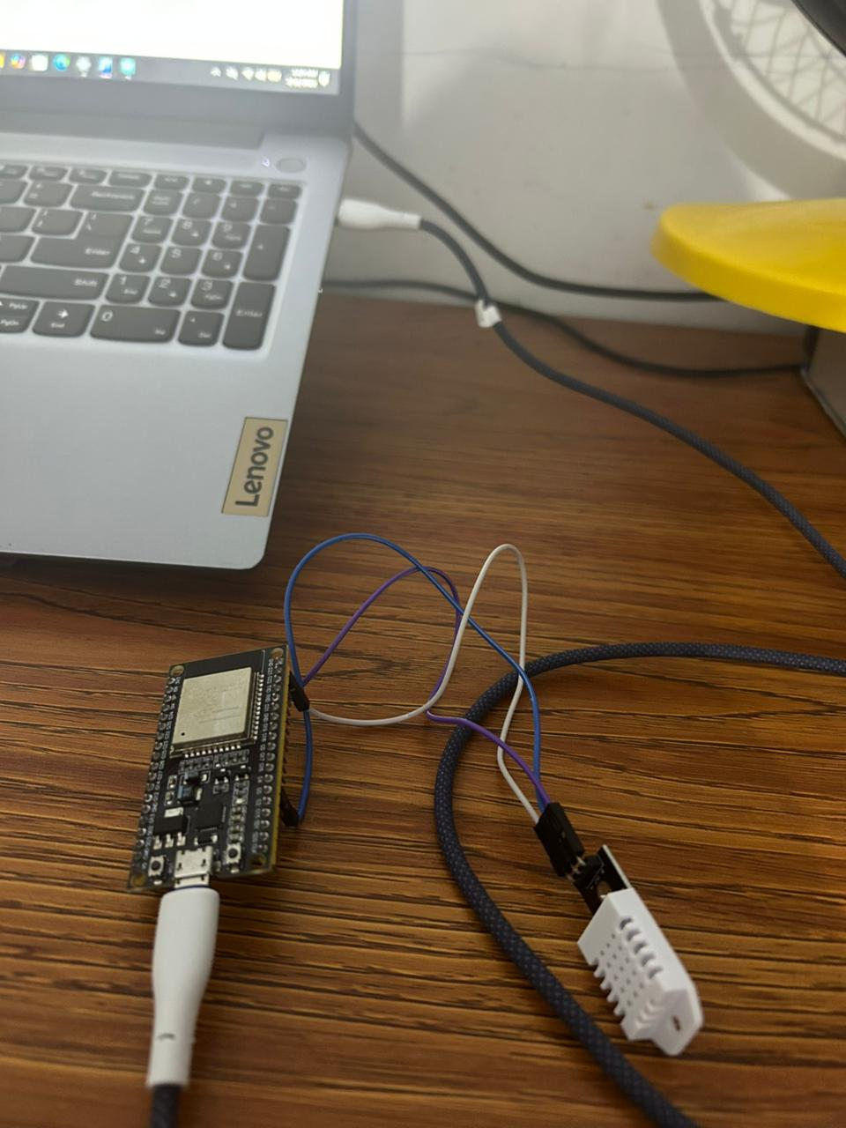
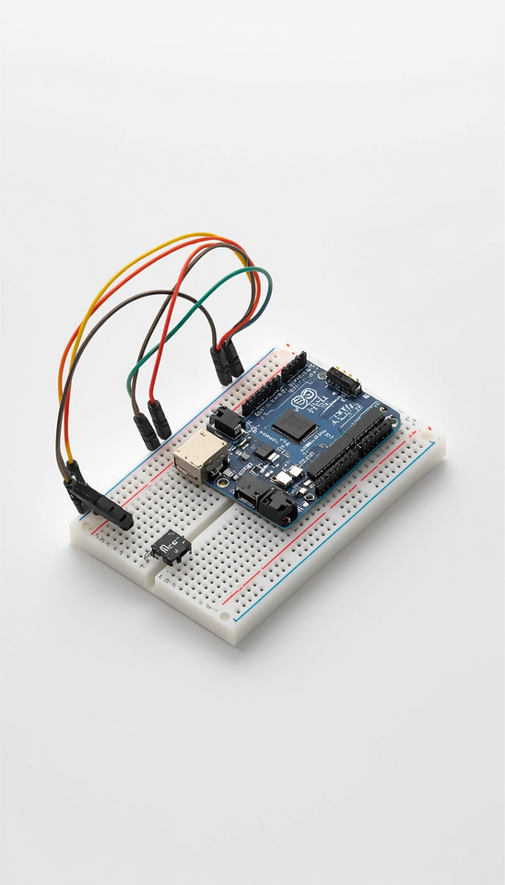
Implementation Methodology
Phase 3: Hardware Assembly
• Connect DHT22 sensor to ESP32 DevKit V1
• Wire VCC to 3.3V, GND to GND, Data to GPIO4
• Install 10kΩ pull-up resistor between VCC and Data pin
• Verify secure connections before powering on
Phase 4: MQTT Broker Setup
• Install Mosquitto MQTT Broker v2.0+ on Windows laptop
• Configure broker with local IP address binding
• Set listener port to 1883 for MQTT communication
• Enable verbose logging for debugging and monitoring

Slide 10

Implementation: Publisher Code & CLI Testing
• CLI Subscription Testing: Utilized mosquitto_sub command-line tool to subscribe to sensor topics (sensors/room1/temperature, sensors/room1/humidity) for real-time message verification
• End-to-End Validation: Confirmed complete data flow from ESP32 publisher through Mosquitto broker to CLI subscriber, validating message integrity and delivery timing
• Debugging & Logging: Enabled verbose broker logging to monitor connection events, subscription requests, and message routing for troubleshooting
• ESP32 Publisher Code Development: Configured Wi-Fi credentials and MQTT broker connection parameters in Arduino IDE; implemented DHT22 sensor reading functions with PubSubClient library for MQTT communication
• Serial Monitor Validation: Verified successful Wi-Fi connection, MQTT broker handshake, and automated publish cycles transmitting temperature/humidity data every 5 seconds to designated topics

Slide 11

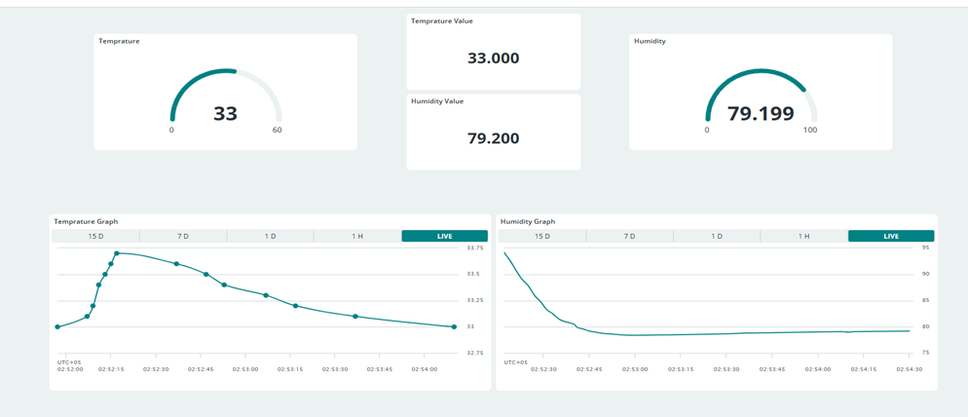
Implementation Methodology - Arduino Cloud Dashboard
• Phase 7: Creating 'ESP32_SensorNode' Thing on Arduino IoT Cloud platform
• Adding cloud variables: temperature, humidity, heatIndex, sensorStatus
• Dashboard configuration: gauges, charts, and status indicators
• Sketch generation and upload to ESP32 microcontroller
• Live data visualization with real-time sensor readings
• Remote monitoring capability through web-based dashboard interface

Slide 12

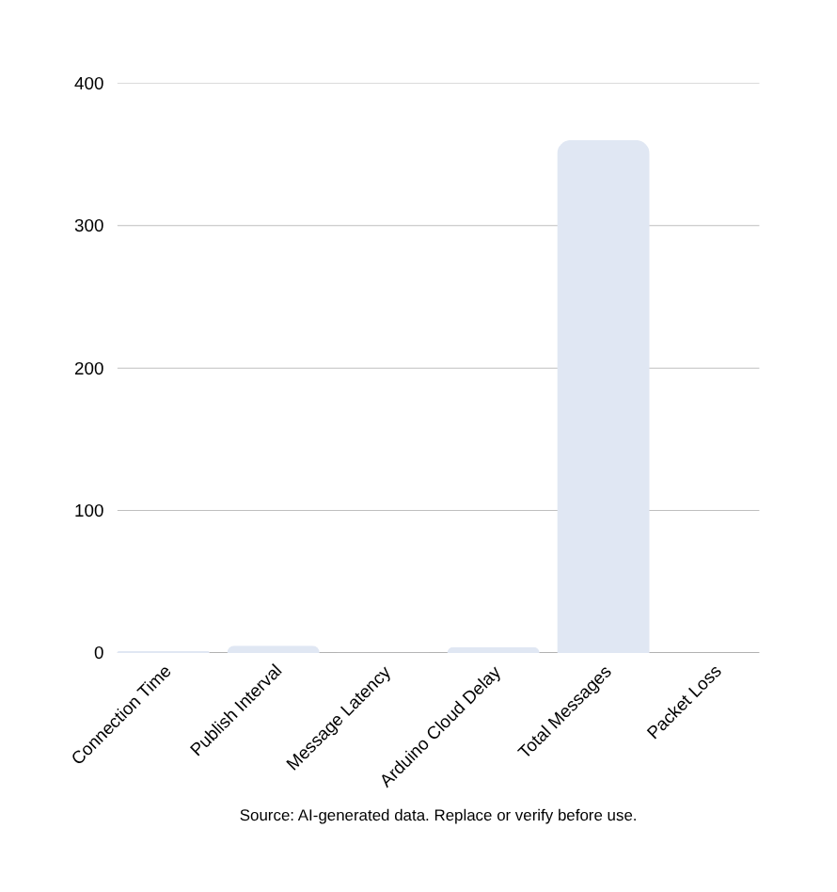
Results: System Performance Metrics
Performance data collected during a 30-minute test demonstrates the reliability and efficiency of the MQTT Pub/Sub system. The ESP32 achieved consistent MQTT connection times of approximately 1.2 seconds, with messages published at 5-second intervals. Message latency remained under 50ms on the local network, while temperature and humidity accuracy met DHT22 specifications at ±0.3°C and ±1.5% RH respectively.

Slide 13

Discussion
MQTT Protocol
Pub/Sub Model
System Benefits
MQTT proves ideal for lightweight, real-time IoT communication. The protocol's minimal overhead ensures efficient data transmission between ESP32 devices and the broker. Low latency (<50ms) supports near-real-time environmental monitoring applications.
The decoupled Publish/Subscribe model offers exceptional scalability and flexibility. Publishers and subscribers operate independently, enabling easy system expansion. Topic-based communication enhances modularity and simplifies system architecture management.
Arduino Cloud integration adds valuable remote monitoring capability with acceptable 3-5 second delay. The system demonstrates reliable performance with zero packet loss over extended testing periods. Overall architecture supports future security enhancements and scaling.

Slide 14


Application of Research Findings in Security
AI-Enhanced SIEM Integration:
• Monitor Mosquitto broker logs using AI-enhanced SIEM systems
• Leverage verbose logging as primary data source for anomaly detection
Deep Learning Applications:
• Deploy Bidirectional LSTM networks to identify abnormal sensor data patterns
• Detect unauthorized broker behavior and suspicious MQTT activities
Security Enhancement Goals:
• Strengthen IoT system security through continuous AI monitoring
• Improve reliability with automated threat detection
• Build resilience against MQTT-specific attacks (flooding, topic enumeration)

Slide 15

THANK YOU
For Your Attention
Questions Welcome

